Slide 1
🎪 ABC Browser Circus
Week 13
Project C – Rainbow Paint Board Presentation

Slide 2
Project Intro
Project Name: Rainbow Painting Board – By Carol
Link: https://fixed-bold-cloche.glitch.me/
Demo:

Slide 3
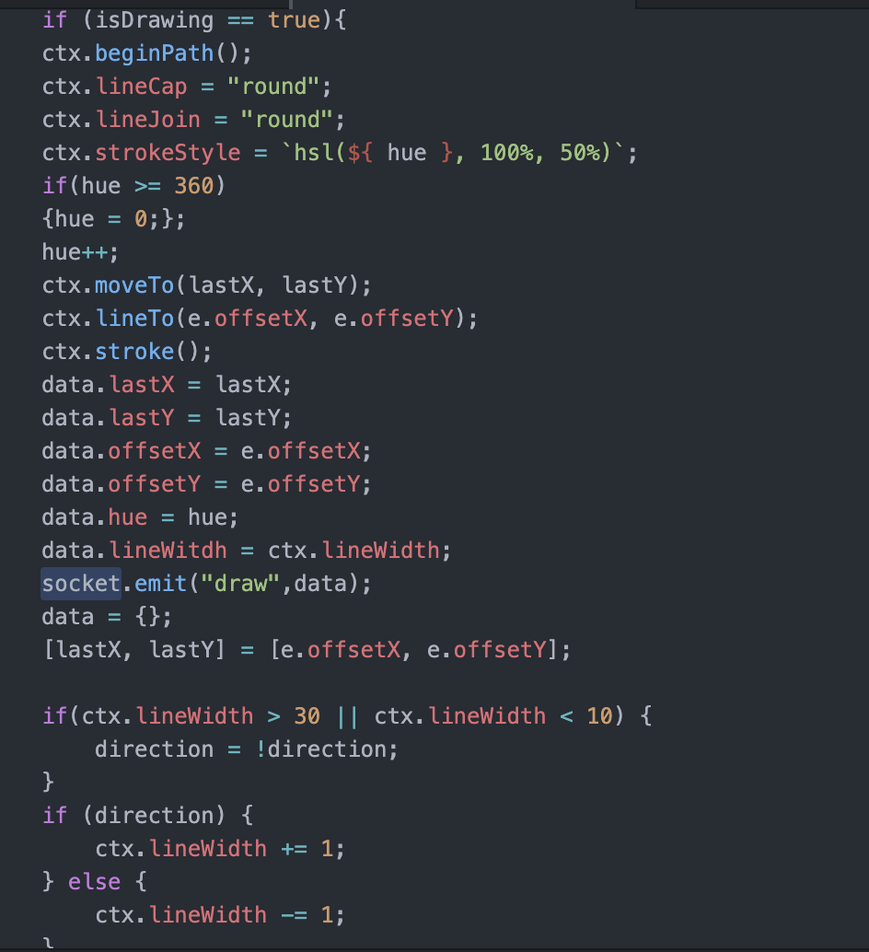
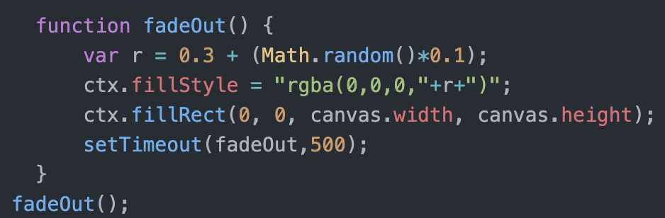
Technical Diagram
Create a Canvas
Get context2d and draw path on the canvas
Based on the mousemove event
if no mousedown event detected, the drawing process
will not begin
Socket.io => send the path to other clients
and draw on the client side

Slide 4
Problems Met
Glitch not working (cannot find express/socket.io)
Solved by manually install express and socket.io
Handle with Fade Out
Used SetTimeOut
Set the opacity to 0

Slide 5
Shortcomings
More functions can be added to make the painting board more interesting
The fade out effect does not look smooth if the site is run on Glitch (it is smooth if is run locally)

